Slide 1
Face Recognition
Presented by: Mostafa Ahmed & Omar Fahmy
Supervised by:
Prof. Dr. rer. nat. Dieter Maier & Joachim Kircher

Slide 2
Outline
Introduction
Open-source models
Our improvements
Problems that we faced
Conclusion

Slide 3
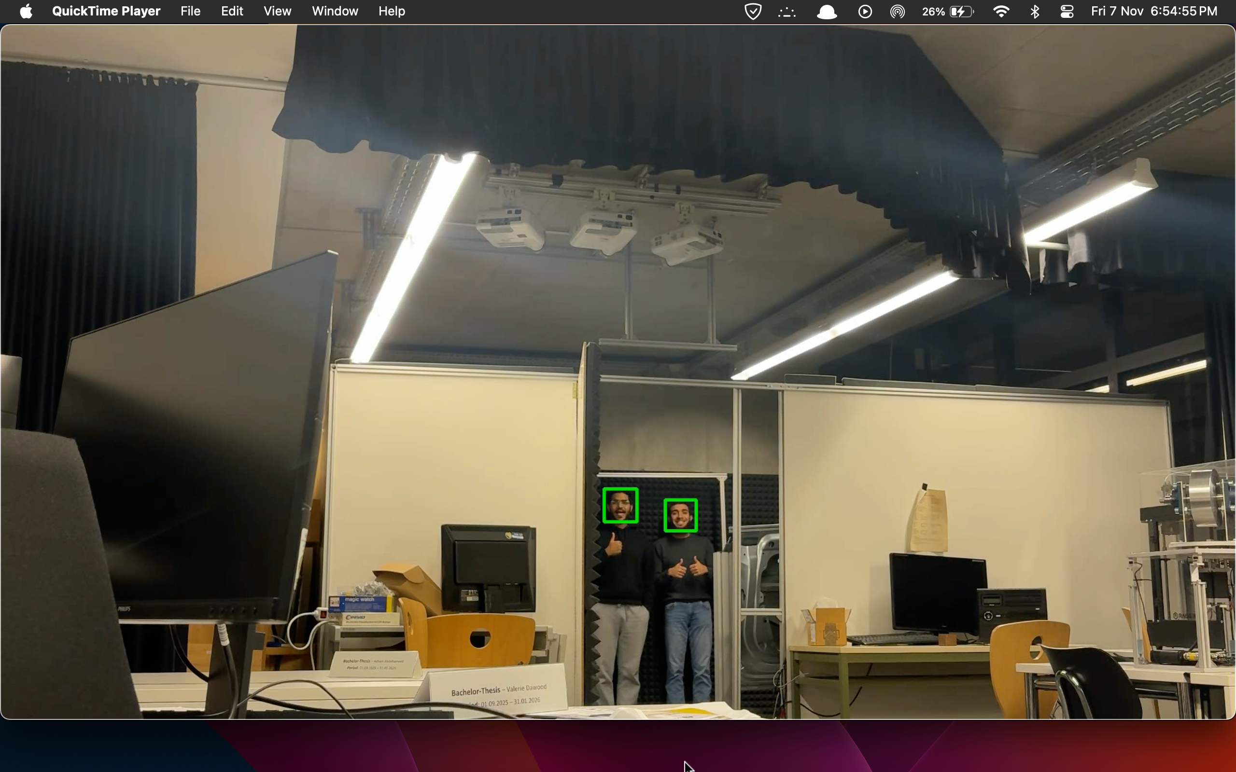
Models that we used & improved
HAAR
For far away faces
DNN
Better detection
Notes:
Better detection -> will show later

Slide 4
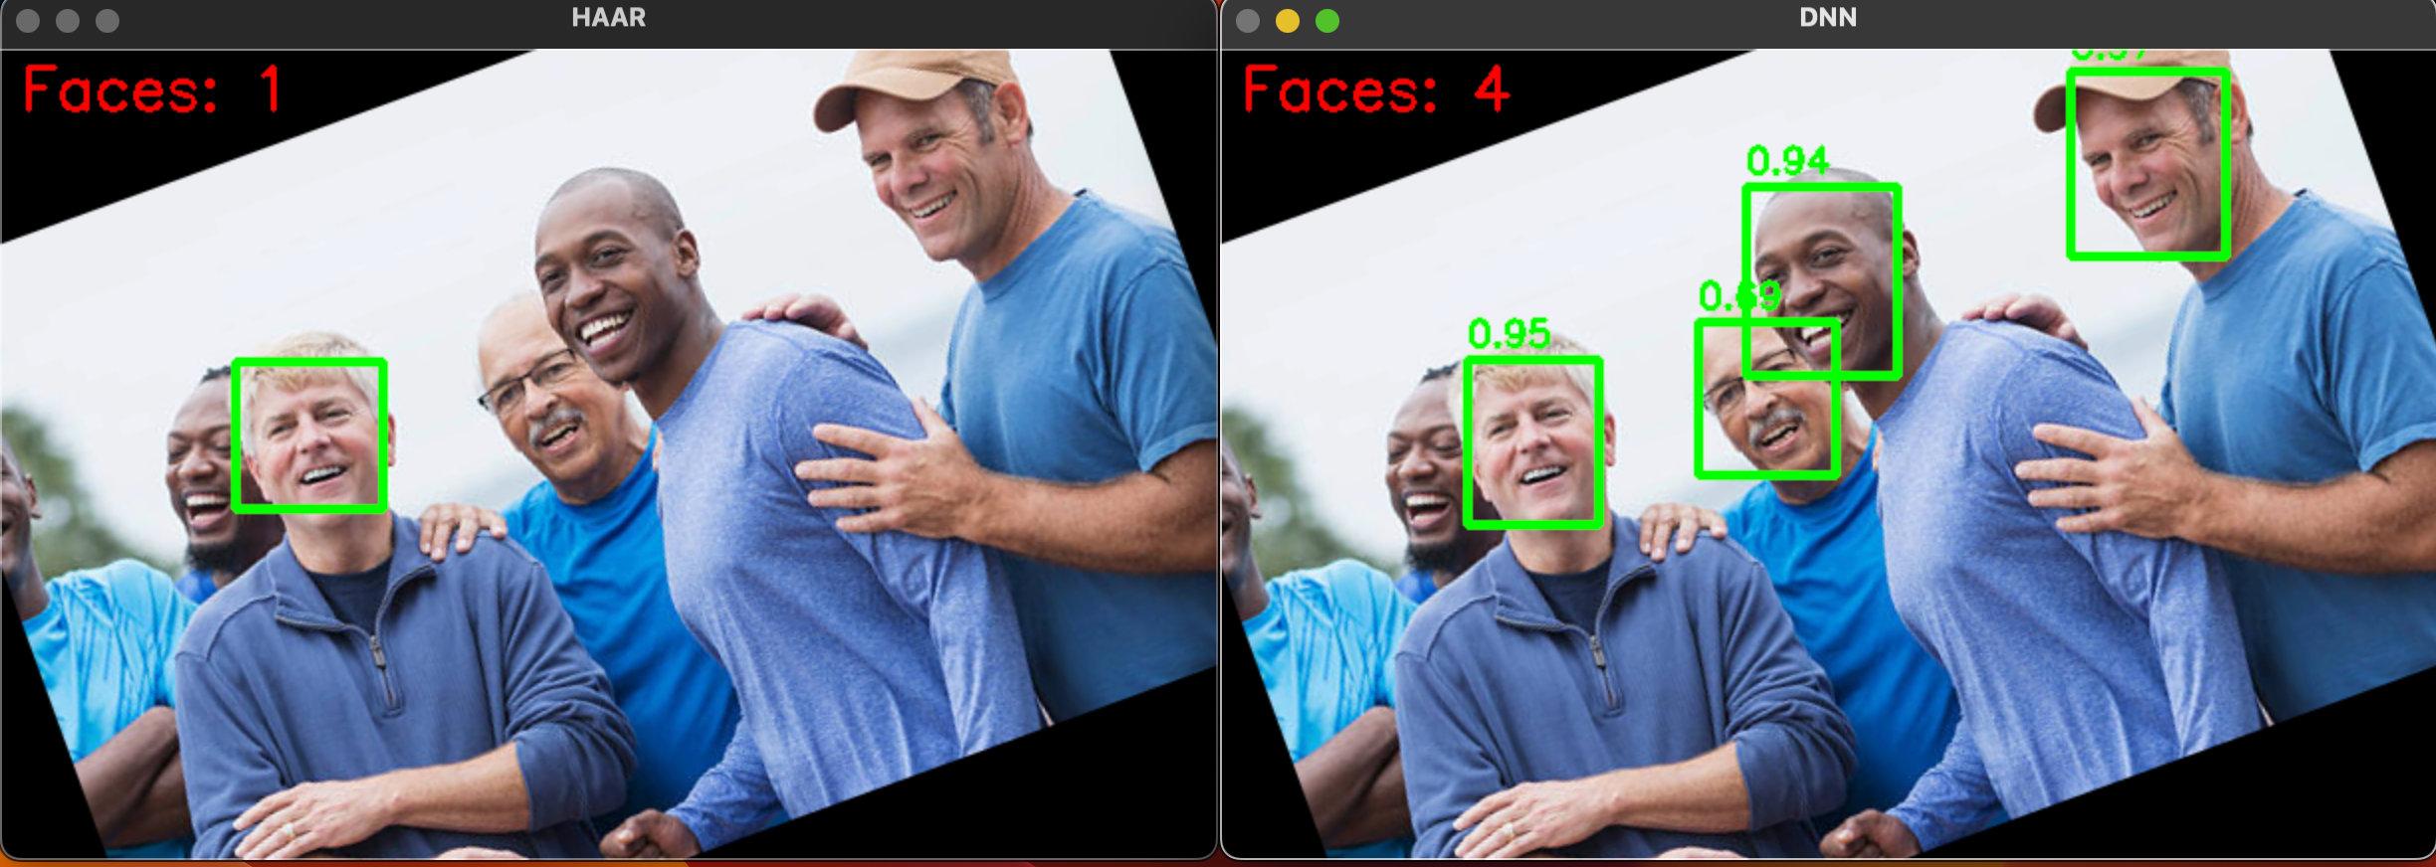
Improvement 1: Multiple angles

Slide 5
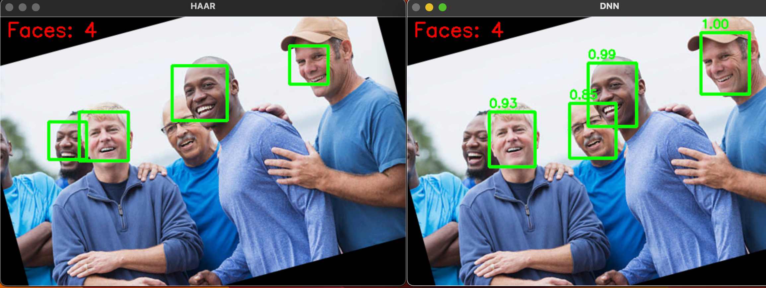
Improvement 1: Multiple angles

Slide 6
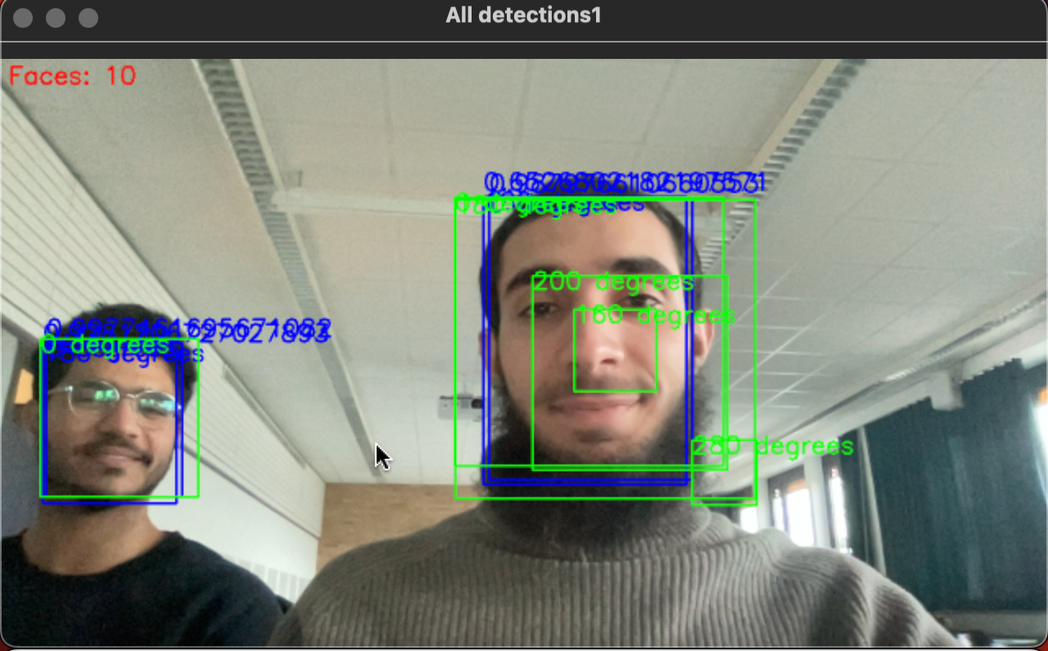
Improvement 1: Multiple angles

Slide 7
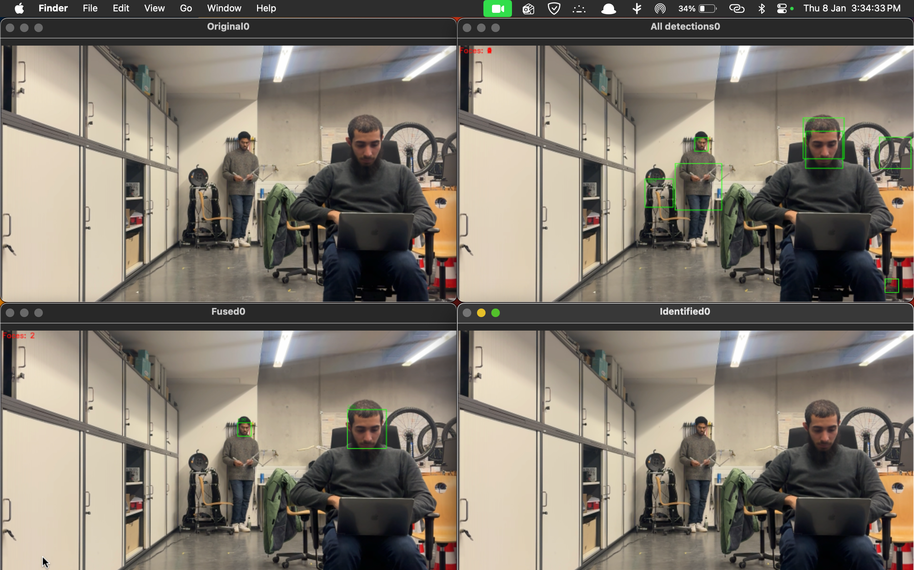
Improvement 2: Model fusion
Notes:
Apply DNN after HAAR after zoom & interpolation

Slide 8
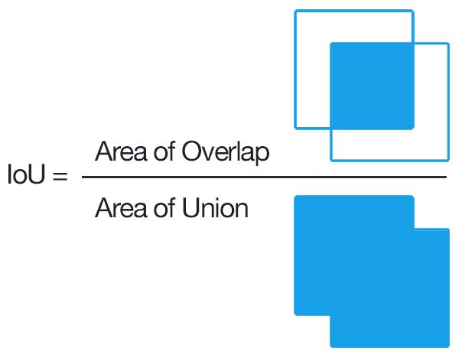
Improvement 3: Merging boxes into 1 box/face
Notes:
We compute the IoU between all detected boxes to find which ones overlap strongly and likely belong to the same object. Boxes with high overlap are clustered together, and each cluster is merged into one final box using confidence-weighted averaging. Finally, low-confidence boxes are filtered out so only clean, reliable detections remain

Slide 9
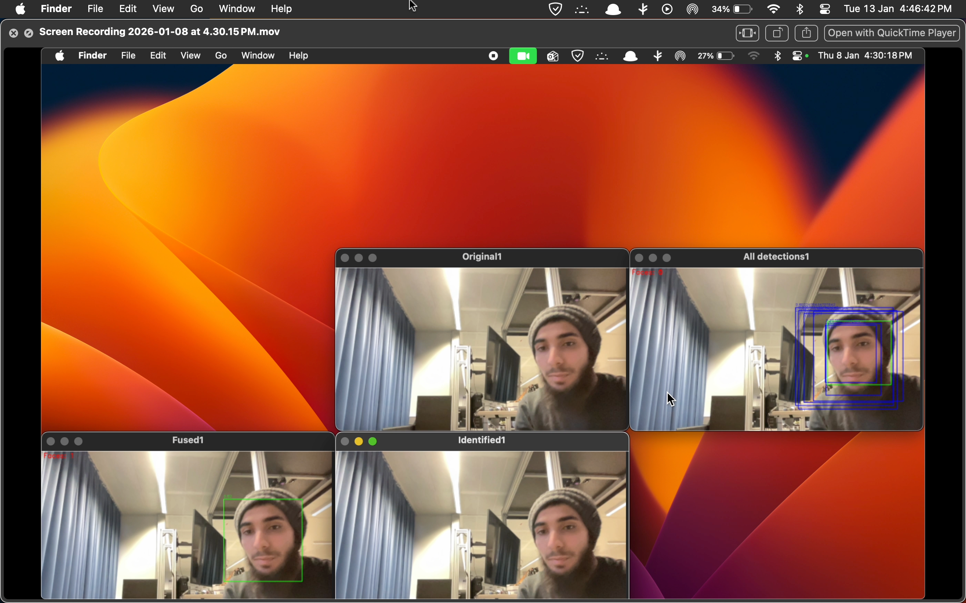
Improvement 3: Merging boxes into 1 box/face

Slide 10
Face Recognition: Chosen Approach
Face Recognition Methodology
For face recognition, we used a feature-based approach InsightFace
Each detected face is converted into a fixed-length embedding vector.
Cosine similarity measures the angle between two feature vectors
High similarity → same person
Low similarity → different person
Decision Rule
If similarity ≥ threshold → known identity
Otherwise → Unknown

Slide 11
Improvement 4: FACE IDENTIFICATION after face alignment
Observed Issue
Even a small face tilt (3–4 degrees) caused:
Correct person → classified as Unknown
This occurred despite correct face detection
Why This Happens
The recognition model was trained mainly on frontal faces
Tilting the face changes:
Relative positions of eyes, nose, and mouth
Geometric relationships inside the embedding
This leads to embedding mismatch during comparison

Slide 12
Eye-Based Face Alignment
Proposed Solution
Use MediaPipe facial landmarks to detect:
Left eye
Right eye
Compute the angle of the line between the two eyes
Rotate the face so the eye line becomes horizontal (0°)
Result
Faces are normalized to a canonical frontal orientation
Embeddings become consistent
Face recognition works correctly even with tilted faces

Slide 13
FACE IDENTIFICATION
How It Works (High Level)
Detect and crop the face (Done by Haar and DNN)
Extract facial landmarks
Generate a normalized feature vector
Compare with known faces using cosine similarity

Slide 14
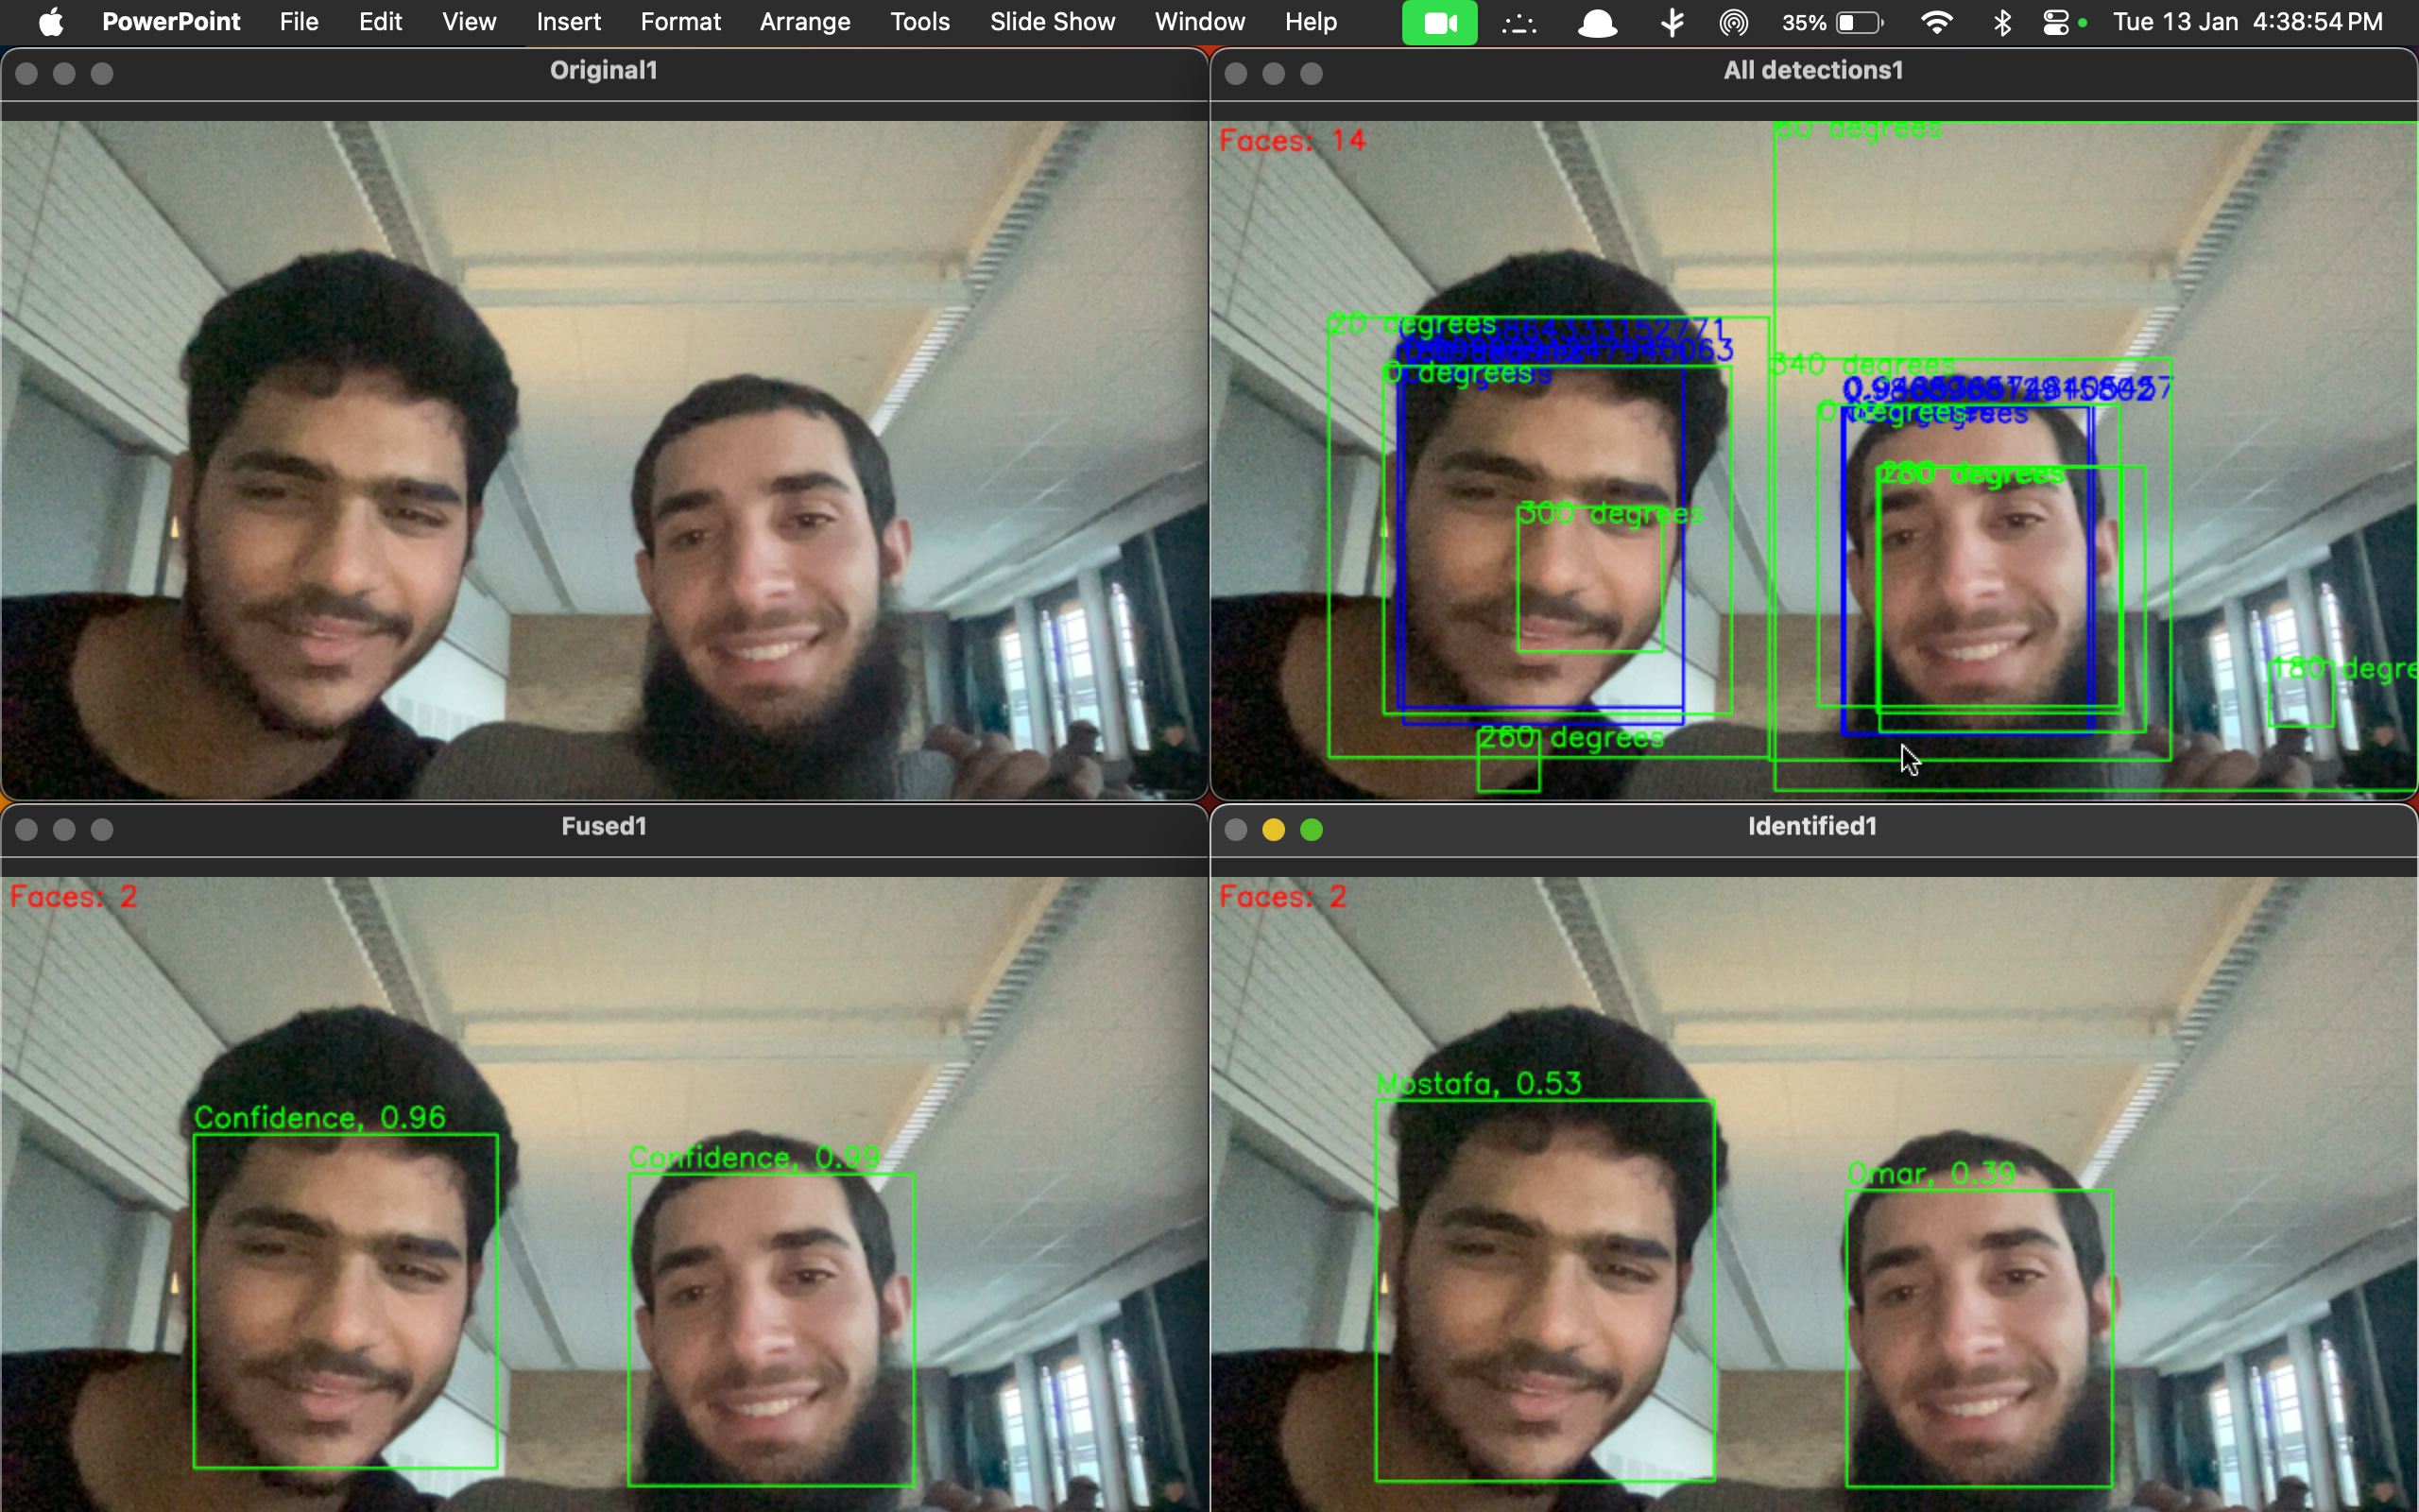
Improvement 4: FACE IDENTIFICATION

Slide 15
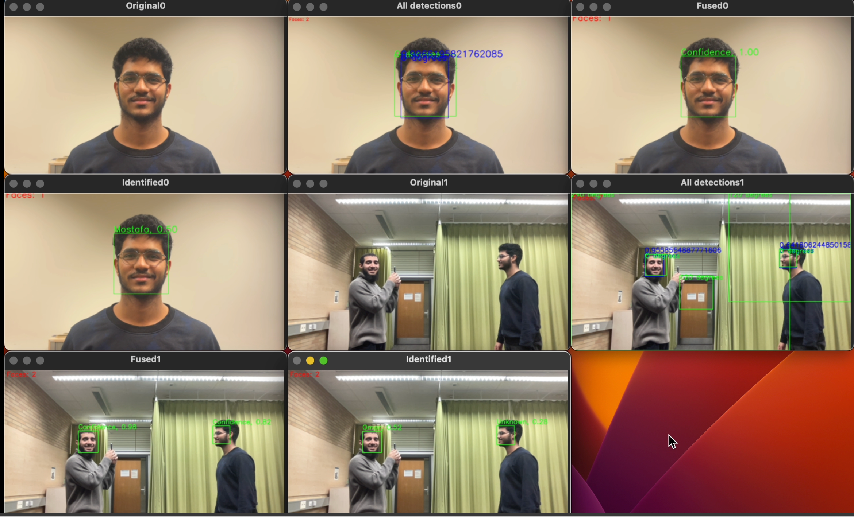
Improvement 5: Multiple cameras

Slide 16
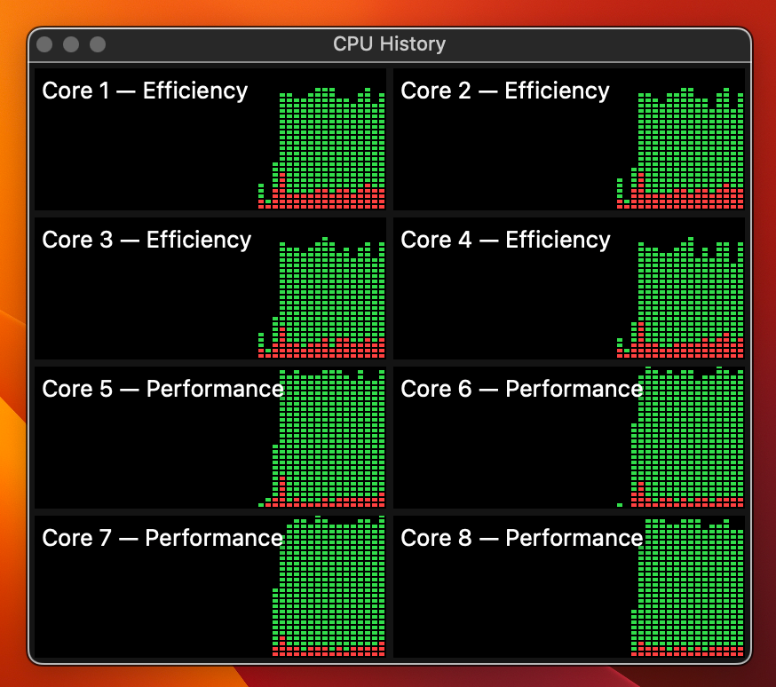
how did we achieve all this in real-time??
CPU Threading
Thread for each angle
Thread for each Face Detection model (HAAR & DNN)
Thread for each camera
Thread for Face Identification

Slide 17
Conclusion
Use open-source HAAR & DNN for face detection
Face detection at multiple angles
Model Fusion between the 2 models.
Merge all boxes into 1 for each face.
Face identification by embedded faces and Cosine Similarity.
Multiple cameras
Live demo!

Slide 18
Thank you!

